Slide 1
MENU DRIVEN PROJECT
Team members
Ankit Kumar Nain (197312780)
Nikhil Kumar (197281210)
Divyanshi Mishra (197476369)
Chetna (197393811)

Slide 2
OBJECTIVE AND SCOPE OF PROJECT
The purpose of the project entitled as “MENU DRIVEN AUTOMATION” is to automate the technologies to develop program which is user friendly simple, fast, increased output, cost – effective. In the technology domain, the impact of automation is increasing rapidly, both in the software/hardware and machine layer.
Automation is a process in which a manually performed action is transformed into one that happens automatically.
The implementation of automation technologies, techniques and processes improve the efficiency, reliability, and/or speed of many tasks that were previously performed by humans.

Slide 3
ABSTRACT
PLATFORM USED: LINUX
FRONT END: PYTHON3
BACK END: PYTHON3
OTHER TOOLS: RHEL 8, AWS, DOCKER

Slide 4
TECHNOLOGIES USED
LINUX
PYTHON
DOCKER
AWS

Slide 5
LINUX
Linux is an open-source operating system like other operating systems.
Linux has many advantages:
(i) Open Source (ii) Free
(iii) Security (iv) Performance
(v) Netwoking (vi) Better Use of Hard Disk

Slide 6
2. PYTHON
First developed in the late 1980s by Guido van Rossum, Python has advanced as an open source programming language by managing public discussion through Python Enhancement Proposals (PEPs).
Python is an interpreted, object-oriented, high-level programming language with dynamic semantics.
Python's simple, easy to learn syntax emphasizes readability and therefore reduces the cost of program maintenance.

Slide 7
Why we used Python for Automation
Automation has to be applied for replacing certain tedious tasks. For instance, if you have to sit and update hundreds of spreadsheet cells, you need to automate that task with Python.
The capability of automation with Python is immense.
Some of the benefits of programming in Python include: (i) Open Source and Community Development (ii) Extensive Support Libraries (iii) Productivity and Speed

Slide 8
3. DOCKER
Docker is a set of platform as a service (PaaS) products that use OS-level virtualization to deliver software in packages called containers
Containers are isolated from one another and bundle their own software, libraries and configuration files; they can communicate with each other through well-defined channels.

Slide 9
4. AWS
AWS (Amazon Web Services) is a comprehensive, evolving cloud computing platform provided by Amazon that includes a mixture of infrastructure as a service (IaaS), platform as a service (PaaS) and packaged software as a service (SaaS) offerings.
AWS services can offer an organization tools such as compute power, database storage and content delivery services.
AWS was one of the first companies to introduce a pay-as-you-go cloud computing model that scales to provide users with compute, storage or throughput as needed.

Slide 10
5. LVM
LVM stands for Logical Volume Management. This is an alternative method of managing storage systems than the traditional partition-based one.
In LVM, instead of creating partitions, you create logical volumes, and then you can just as easily mount those volumes in your filesystem as you'd a disk partition.
Components of LVM: (i) Physical Volumes (ii) Volume Groups (iii) Logical Volumes

Slide 11
Project Code
integrate.py
aws.py
docker.py
lvm.py
basic.py

Slide 12
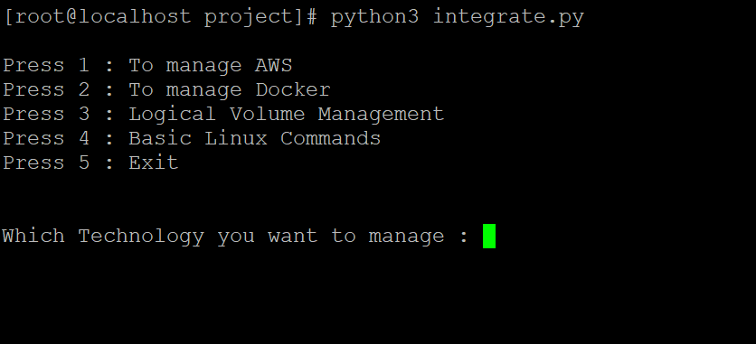
DESCRIPTION OF PROJECT
This project contains a menu to automate AWS, Docker, LVM and basic Linux Commands. On selecting an option it will redirect to the selected module.

Slide 13
AWS Module Working: This menu contains options to login into AWS CLI, launch an instance, start and stop instance, create a volume and so on.
AWS Commands used:
aws configure
aws ec2 run-instances <options>
aws ec2 start-instances
aws ec2 describe-instances
aws ec2 stop-instances

Slide 14
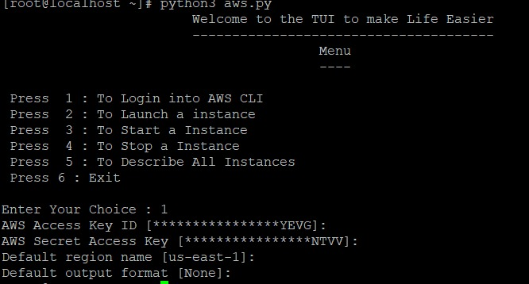

Slide 15
Docker Module Working: This menu contains options to start a docker service, pull image, launch and delete containers and so on.
Docker Commands Used:
Start Docker Service: systemctl start docker
List docker images: docker images
Run docker container: docker run -it –name <name>
List running docker containers: docker ps –a
Pull Image from docker registry for creating container: docker pull <image>:<version>
Stop docker container: docker stop <name>
Stop Docker Service: systemctl stop docker

Slide 16
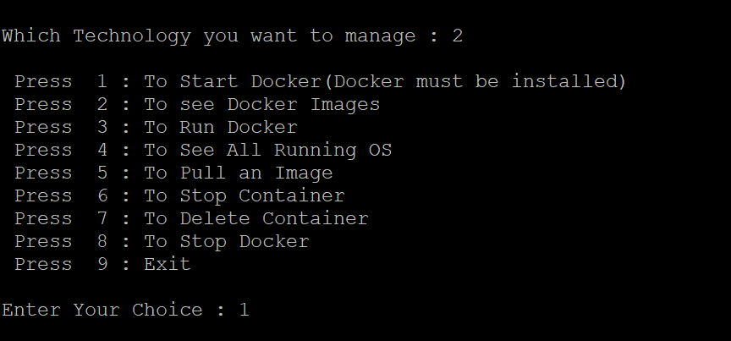

Slide 17
LVM Module Working: This menu contains options to create and display physical volumes, logical volumes, volume groups, extend the volumes and so on. LVM Commands:
Create Physical Volume: pvcreate, pvdisplay
Create Volume Group: vgcreate, vgdisplay
Create Logical Volume: lvcreate, lvdisplay
Extend Volumes: resize2fs

Slide 18
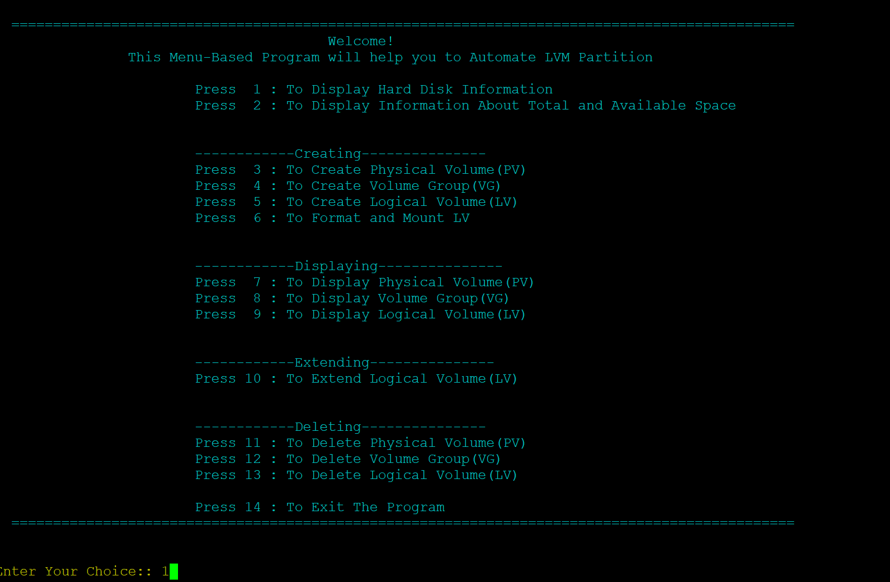

Slide 19
Basic Linux Command Module Working This menu contains options to run commands like date, ls, cal, and command to show IP and running processes and so on
Some basic Linux commands are:
To display date: date
To list the contents: ls
To display calender: cal
To display IP: ifconfig

Slide 20
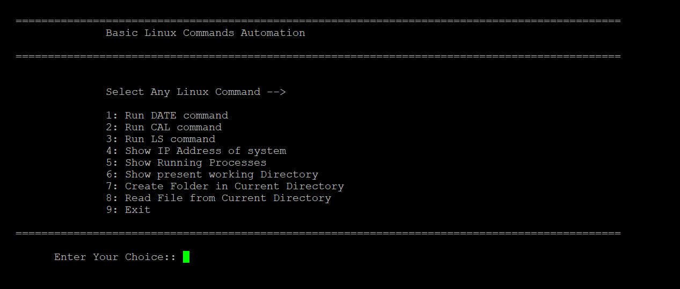

Slide 21
Link to the Code
Menu Driven Project

